Slide 1

Topic 3
Data Visualization Using Matplotlib

Slide 2
Contents
Contents
Intro to Matplotlib
A first taste of Matplotlib
Adding Legends, Set Axis Limits, Add xticks/yticks
Controlling Line Properties
Subplots methods
Working with multiple figures
Saving Figures
Working with Text
Bar charts
Piecharts
Histograms
Scatter Plots
Box Plots
Display images
Interactive Charts

Slide 3
Intro to Matplotlib
Notes:
https://matplotlib.org/users/intro.html
https://matplotlib.org/examples/pylab_examples/subplots_demo.html
http://www.python-course.eu/matplotlib_multiple_figures.php

Slide 4
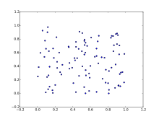
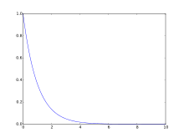
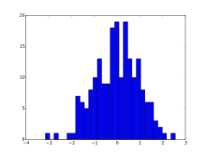
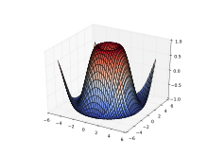
What is Matplotlib?
Intro to Matplotlib
Matplotlib is a library for making 2D plots of arrays in Python
The latest version of Matplotlib (as of Sep 2020) is 3.3.2

Slide 5
Matplotlib is both easy yet powerful
Intro to Matplotlib
Produces publication quality figures in a variety of hardcopy formats and interactive environments across platforms
Can be used in Python scripts, Jupyter notebook, web application servers, and four graphical user interface toolkits
For simple plotting, the pyplot module provides a MATLAB-like interface, particularly when combined with IPython
For the power user, you have full control of line styles, font properties, axes properties, etc, via an object oriented interface or via a set of functions familiar to MATLAB users

Slide 6
Installing Matplotlib
Intro to Matplotlib
If you don’t already have Python installed, start off with Anaconda, which has matplotlib and many of its dependencies, plus other useful packages, preinstalled.
For standard Python installations, install matplotlib using pip:
pip install matplotlib

Slide 7
A first taste of Matplotlib

Slide 8
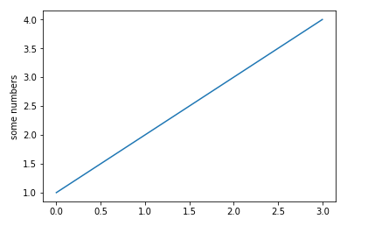
Plot a line graph (supply y values only)
A first taste of Matplotlib
import matplotlib.pyplot as plt
plt.plot([1,2,3,4])
plt.ylabel('some numbers')
plt.show()
If you provide a single list or array to the plot() command, matplotlib assumes it is a sequence of y values, and automatically generates the x values for you
Since python ranges start with 0, the default x vector has the same length as y but starts with 0
Hence the x data are [0,1,2,3].

Slide 9
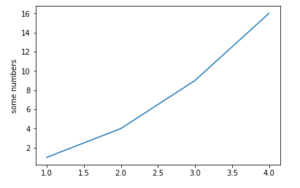
Plot a line graph (supply y+x values)
A first taste of Matplotlib
import matplotlib.pyplot as plt
plt.plot([1, 2, 3, 4], [1, 4, 9, 16])
plt.ylabel('some numbers')
plt.show()
To plot x versus y, you can issue the commands above

Slide 10
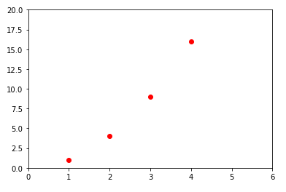
Plot a line graph (specify color and pattern)
A first taste of Matplotlib
import matplotlib.pyplot as plt
plt.plot([1,2,3,4], [1,4,9,16], 'ro')
plt.show()
You can specify a third argument which is the format string that indicates the color and line type of the plot
The default format string is 'b-' which is a solid blue line
To plot the above with red circles, you would use 'ro' instead
Refer to link below for more marker styles https://matplotlib.org/api/markers_api.html
Notes:
https://matplotlib.org/api/markers_api.html

Slide 11
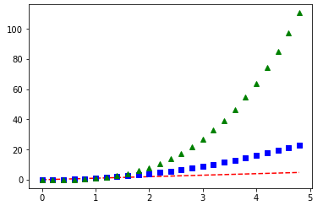
Plot a line graph (with numpy arrays)
A first taste of Matplotlib
import numpy as np
import matplotlib.pyplot as plt
# Create numpy array with values # between 0 and 5 in steps of 0.2
t = np.arange(0, 5, 0.2)
plt.plot(t, t, 'r--')
plt.plot(t, t**2, 'bs‘)
plt.plot(t, t**3, 'g^')
plt.show()
Though the previous examples show how matplotlib is used with lists, generally, matplotlib is used with numpy arrays for data processing
The example above illustrates a plotting several lines with different format styles using numpy arrays.
Notes:
https://matplotlib.org/api/markers_api.html

Slide 12
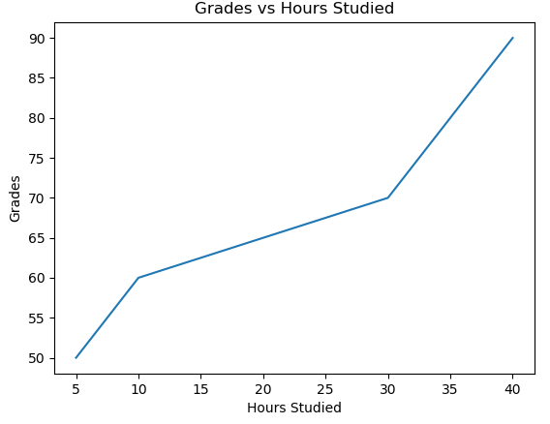
Add titles and labels
A first taste of Matplotlib
import matplotlib.pyplot as plt
plt.title('Grades vs Hours Studied')
plt.xlabel('Hours Studied')
plt.ylabel('Grades')
plt.plot([5,10,30,40], [50,60,70,90])
plt.show()

Slide 13
 | description
'-' | solid line style
'--' | dashed line style
'-.' | dash-dot line style
':' | dotted line style
'.' | point marker
',' | pixel marker
'o' | circle marker
's' | square marker
'p' | pentagon marker
'*' | star marker
'h' | hexagon1 marker
'H' | hexagon2 marker
'+' | plus marker
'x' | x marker
 | description
'v' | triangle_down marker
'^' | triangle_up marker
'<' | triangle_left marker
'>' | triangle_right marker
'1' | tri_down marker
'2' | tri_up marker
'3' | tri_left marker
'4' | tri_right marker
'D' | diamond marker
'd' | thin_diamond marker
'|' | vline marker
'_' | hline marker
The following format string characters are accepted to control the line style or marker

Slide 14
 | color
b’ | blue
‘g’ | green
‘r’ | red
‘c’ | cyan
‘m’ | magenta
‘y’ | yellow
‘k’ | black
‘w’ | white
The following color abbreviations are supported
In addition, you can specify colors in other ways
full names ('green')
hex strings ('#008000')
RGB or RGBA tuples ((0,1,0,1))
grayscale intensities as a string ('0.8')

Slide 15
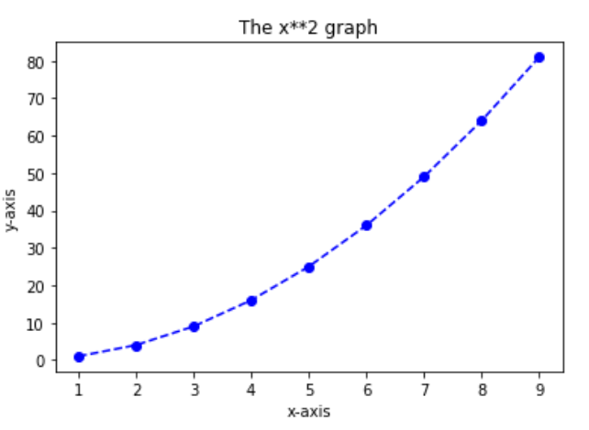
Class Exercise
Draw the following with the help of numpy package

Slide 16
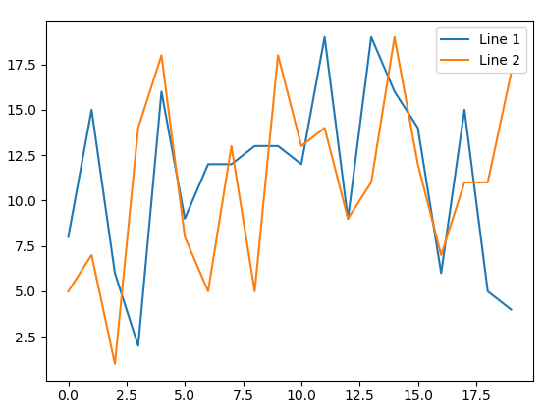
Add legend to a plot (Example 1)
Adding Legends
Call plt.legend to add a legend to a plot
import numpy as np
import matplotlib.pyplot as plt
line_1 = np.random.randint(1,20,20)
line_2 = np.random.randint(1,20,20)
plt.plot(line_1,label="Line 1")
plt.plot(line_2,label="Line 2")
legend = plt.legend()
plt.show()

Slide 17
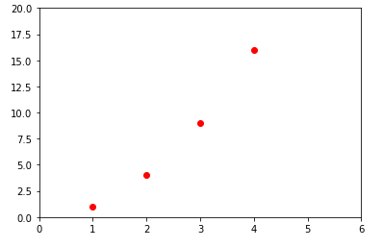
Set axis limits (ylim and xlim method)
Set Axis Limits
import matplotlib.pyplot as plt
plt.plot([1,2,3,4], [1,4,9,16], 'ro')
plt.xlim(0,6)
plt.ylim(0,20)
plt.show()

Slide 18
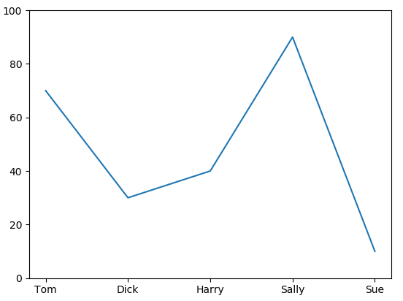
Add x-ticks
Adding x-ticks, y-ticks
Call plt.xticks to add xticks to a plot
import numpy as np
import matplotlib.pyplot as plt
y = [70,30,40,90,10]
xlabels = ('Tom', 'Dick', 'Harry', 'Sally', 'Sue')
plt.xticks(np.arange(5),xlabels)
plt.ylim(0,100)
plt.plot(y)
plt.show()
Notes:
Note:
In matplotlib, ticks are small marks on both the axes of a figure.

Slide 19
Controlling Line Properties

Slide 20
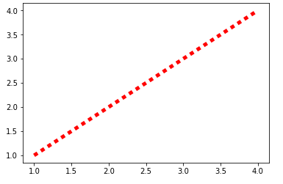
Using keyword args with plot method
Controlling Line Properties
import matplotlib.pyplot as plt
x,y = [1,2,3,4],[1,2,3,4]
plt.plot(x, y, linewidth=5, linestyle="dotted",
color="red")
plt.show()
Lines have many attributes that you can set: linewidth, dash style, antialiased
One easy way to control the line attributes is to add them as keyword args when you call the plot method

Slide 21
Using subplots method
Working with multiple plots and figures
plt.subplots() is a function that returns a tuple containing a figure and axes object(s)
Thus when using plt.subplots() you unpack this tuple into the variables fig and ax
fig, ax = plt.subplots()
Having a fig object is useful if you want to change figure-level attributes or save the figure as an image file later (e.g. with fig.savefig('yourfilename.png')
Having an axes object is useful if you want to change axis-level attributes (e.g. customize ticks, pan/zoom axis etc)

Slide 22
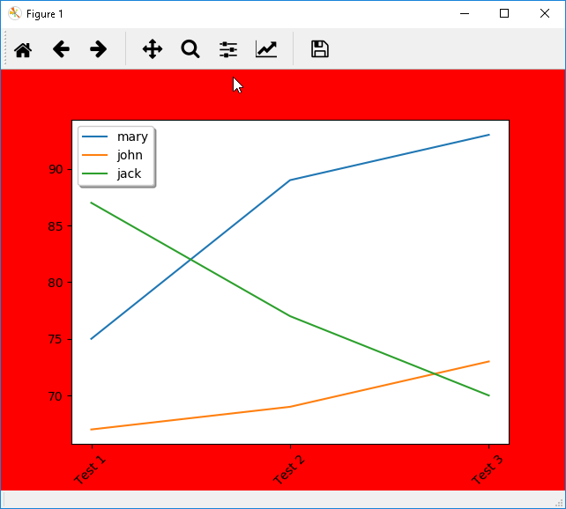
Using fig and ax objects
Working with multiple plots and figures
import numpy as np
import matplotlib.pyplot as plt
x_labels = ["Test 1", "Test 2", "Test 3"]
mary = [75,89,93]
john = [67,69,73]
jack = [87,77,70]
fig,ax = plt.subplots()
fig.set_facecolor("red")
ax.set_xticks(np.arange(3)) ax.set_xticklabels(x_labels, rotation=45)
ax.plot(mary,label="mary") ax.plot(john,label="john") ax.plot(jack,label="jack")
legend = ax.legend(loc='upper left', shadow=True)
plt.show()

Slide 23
Plotting multiple plots or multiple figures
Working with multiple figures and axes
Matplotlib allows you to plot multiple plots on a single figure or plot multiple plots on multiple figures using the subplot and figure commands
The examples that follow in this section illustrate how you can plot multiple subplots on a single figure, as well as plot them on different figures, which allows you to save them separately as individual image files
Notes:
https://stackoverflow.com/questions/34162443/why-do-many-examples-use-fig-ax-plt-subplots-in-matplotlib-pyplot-python
http://matplotlib.org/api/pyplot_api.html#matplotlib.pyplot.subplots

Slide 24
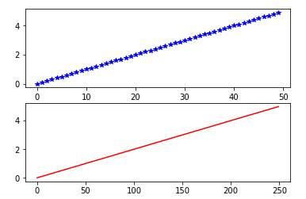
Two subplots on 1 figure (Example 1)
Working with multiple figures and axes
import numpy as np
import matplotlib.pyplot as plt
t1 = np.arange(0.0, 5.0, 0.1)
t2 = np.arange(0.0, 5.0, 0.02)
plt.figure(1)
plt.subplot(211)
plt.plot(t1,'b*')
plt.subplot(212)
plt.plot(t2,'r-')
plt.show()
Create a multi-plot by first declaring the figure with a unique reference number, then the subplot method with a unique reference number, followed by the plot method
subplot(nrows, ncols, plot_number)

Slide 25
How to change size of figure
Working with multiple figures and axes
plt.figure(figsize=(12,6))
plt.show()

Slide 26
Working with Text

Slide 27
Working with Text
Working with Text
The following commands are used to create text in the pyplot interface
The text() command can be used to add text in an arbitrary location
xlabel(), ylabel() and title() are used to label the axes
All of these functions create and return a matplotlib.text.Text() instance, which can be configured with a variety of font and other properties
Method | Description
text | add text at an arbitrary location to the Axes
xlabel | add a label to the x-axis
ylabel | add a label to the y-axis
title | add a title to the Axes
figtext | add text at an arbitrary location to the Figure
subtitle | add a title to the Figure
annotate | add an annotation, with optional arrow, to the Axes

Slide 28
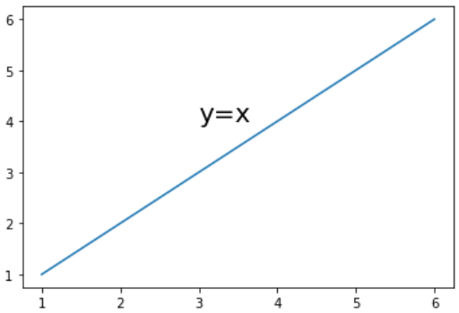
Add text at a location
Working with Text
import matplotlib.pyplot as plt
plt.plot([1,2,3,4,5,6], [1,2,3,4,5,6])
plt.text(3, 4, 'y=x', fontsize=20)
plt.show()
The text() command places text at an arbitrary position

Slide 29
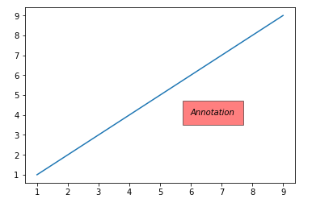
Annotating with Text with Box
Working with text
import numpy as np
import matplotlib.pyplot as plt
x1 = np.arange(1,10,2)
y1 = np.arange(1,10,2)
plt.plot(x1,y1)
plt.text(6, 4, 'Annotation', style='italic',
bbox={'facecolor':'red', 'alpha':0.5, 'pad':10})
plt.show()

Slide 30
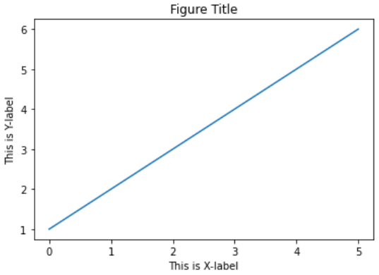
Add labels and titles
Working with Text
import matplotlib.pyplot as plt
plt.plot([1,2,3,4,5,6])
plt.title('Figure Title')
plt.xlabel('This is X-label')
plt.ylabel('This is Y-label')
plt.show()

Slide 31
Bar charts

Slide 32
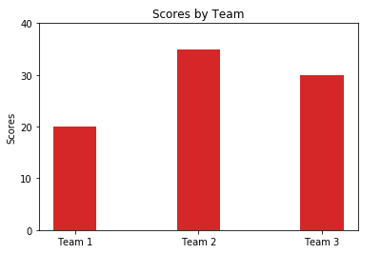
Bar Charts (Example #1)
Bar Charts
import numpy as np
import matplotlib.pyplot as plt
teams = np.arange(3)
scores = (20, 35, 30)
width = 0.35
plt.bar(teams, scores, width, color='#d62728')
plt.ylabel('Scores')
plt.title('Scores by Team')
plt.xticks(teams,
('Team 1', 'Team 2','Team 3'))
plt.yticks(np.arange(0, 50, 10))
plt.show()

Slide 33
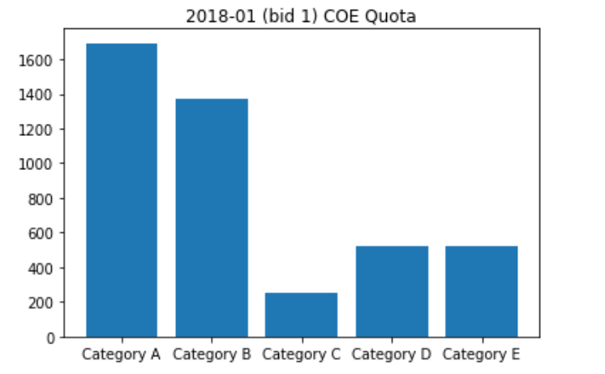
Bar Charts (Example #2)
Bar Charts
import numpy as np
import matplotlib.pyplot as plt
data = np.genfromtxt("data/coe-results.csv",
delimiter=',',
names=True, dtype=('U7',int,'U10',int,int,int,int))
data2018 = data[(data['month']=='2018-01')]
data2018_1 = data2018[data2018['bidding_no']==1]
plt.title('2018-01 (bid 1) COE Quota')
plt.bar(data2018_1['vehicle_class'],
data2018_1['quota'])
plt.show()

Slide 34
Pie charts

Slide 35
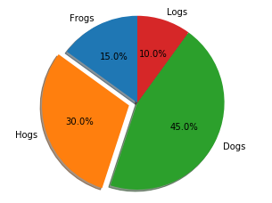
Pie Charts (Example #1)
Pie Charts
import matplotlib.pyplot as plt
# Slices are ordered, anti-clockwise
labels = 'Frogs', 'Hogs', 'Dogs', 'Logs'
sizes = [15, 30, 45, 10]
explode = (0, 0.1, 0, 0) # Explode 2nd
fig1, ax1 = plt.subplots()
ax1.pie(sizes, explode=explode, labels=labels, autopct='%1.1f%%',
shadow=True, startangle=90)
# Eq aspect ratio draws pie as circle
ax1.axis('equal')
plt.show()

Slide 36
Pie Charts (Example #2)
Pie Charts
import numpy as np
import matplotlib.pyplot as plt
data = np.genfromtxt("data/coe-results.csv",
delimiter=',',
names=True, dtype=('U7',int,'U10',int,int,int,int))
data2018_01 = data[(data['month']=='2018-01')]
data2018_01_1 = data2018_01[data2018_01['bidding_no']==1]
# Extract rows containing required keywords only
data2018_01_1 = data2018_01_1[np.isin(data2018_01_1['vehicle_class'],
['Category A', 'Category B', 'Category C', 'Category D','Category E'])]

Slide 37
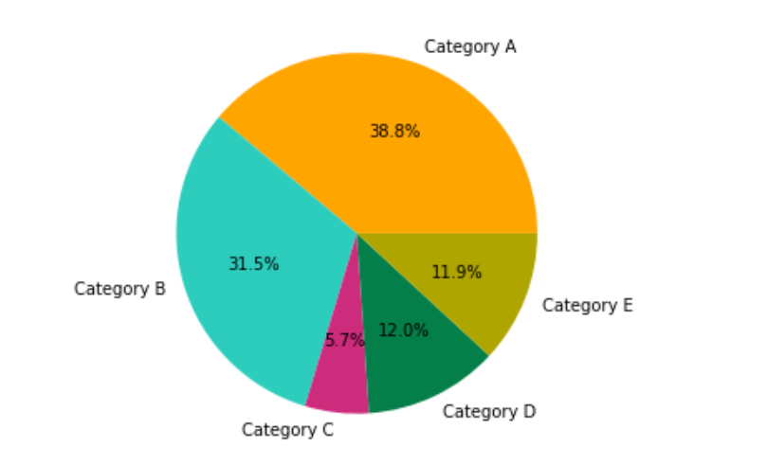
Pie Charts (Example #2)
Pie Charts
labels = data2018_01_1['vehicle_class']
values = data2018_01_1['quota']
colors = ['#FFA500', '#2CCDBD', '#CD2C7D', '#057F4A','#AFA500']
explode = (0.1, 0, 0, 0)
plt.figure(figsize=(5,5))
plt.pie(values, labels=labels, colors=colors, autopct='%1.1f%%')
plt.show()

Slide 38
Histograms
Notes:
https://matplotlib.org/api/pyplot_api.html?highlight=hist#matplotlib.pyplot.hist

Slide 39
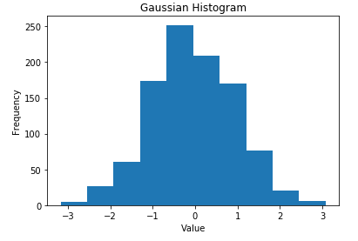
Example #1 - Single dataset
Histograms
import numpy as np
import matplotlib.mlab as mlab
import matplotlib.pyplot as plt
gaussian_numbers = np.random.randn(1000)
plt.hist(gaussian_numbers)
plt.title("Gaussian Histogram")
plt.xlabel("Value")
plt.ylabel("Frequency")
plt.show()

Slide 40
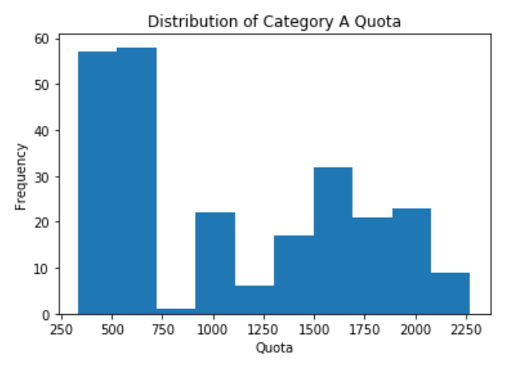
Example #2
Histograms
import numpy as np
import matplotlib.pyplot as plt
#read in the dataset
data = np.genfromtxt("data/coe-results.csv",
delimiter=',',
names=True, dtype=('U7',int,'U10',int,int,int,int))
#set up the values
catA = data[data['vehicle_class'] == 'Category A']['quota']
#label the plot
plt.title('Distribution of Category A Quota')
plt.xlabel('Quota')
plt.ylabel('Frequency')
#plot the histogram
plt.hist(catA)
plt.show()
Notes:
Explain the bins concept?

Slide 41
Scatter Plots
Notes:
https://matplotlib.org/api/pyplot_api.html?highlight=scatter#matplotlib.pyplot.scatter

Slide 42
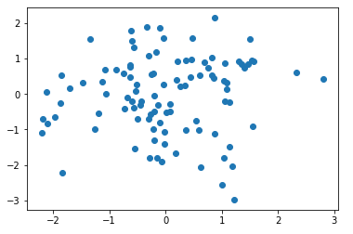
Scatter Plots (Example #1)
Scatter Plots
import numpy as np
import matplotlib.pyplot as plt
x = np.random.randn(100)
y = np.random.randn(100)
plt.scatter(x,y)
plt.show()

Slide 43
Scatter Plots (Example #2)
Scatter Plots
The local ice cream shop keeps track of how much ice cream they sell versus the noon temperature on that day.
Here are their figures for the last 12 days
See the next slide for how the same data is plotted as a scatter plot
Temperature | Ice-cream sales
14.2 | 215
16.4 | 325
11.9 | 185
15.2 | 332
18.5 | 406
22.1 | 522
19.4 | 412
25.1 | 614
23.4 | 544
18.1 | 421
22.6 | 445
17.2 | 408

Slide 44
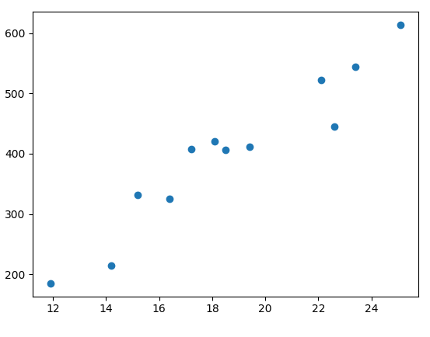
Scatter Plots (Example #2)
Scatter Plots
import numpy as np
import matplotlib.pyplot as plt
data = np.loadtxt("icecream.csv",delimiter=",")
# split the data into x and y arrays
x,y = np.split(data, 2, axis=1)
plt.scatter(x,y)
plt.show()

Slide 45
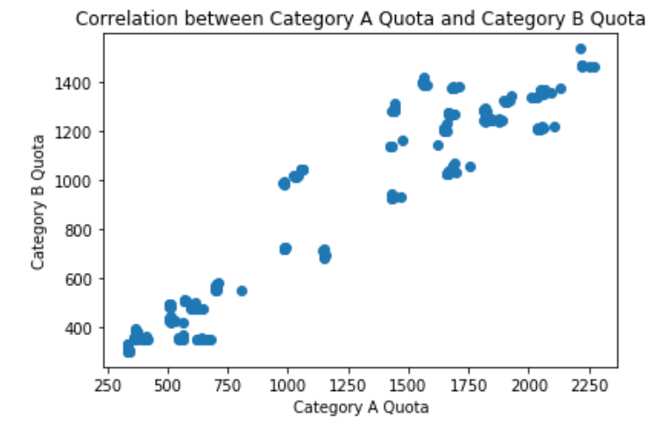
Scatter Plots (Example #3)
Scatter Plots
import numpy as np
import matplotlib.pyplot as plt
#read in the dataset
data = np.genfromtxt("data/coe-results.csv",
delimiter=',',
names=True,
dtype=('U7',int,'U10',int,int,int,int))
#set up the values
catA = data[data['vehicle_class'] == 'Category A']['quota']
catB = data[data['vehicle_class'] == 'Category B']['quota']
#label the plot
plt.title('Correlation between Category A Quota and Category B Quota')
plt.xlabel('Category A Quota')
plt.ylabel('Category B Quota')
#plot the scatter plot
plt.scatter(catA, catB)
plt.show()

Slide 46
Box Plots
Notes:
https://matplotlib.org/api/pyplot_api.html?highlight=scatter#matplotlib.pyplot.scatter

Slide 47
Box Plots (Example #1)
Box Plots
This example shows how you can create a box-plot that shows the median of the number of hours 6 students sleep in a week
import matplotlib.pyplot as plt
import numpy as np
# No.hours 6 students sleep in a week data = np.array([(8,5,7,3,4,5,9),(6,5,6,8,8,8,6),(4,5,7,6,6,7,9), (3,5,7,8,8,7,6),(3,6,7,7,7,6,6),(8,7,6,6,7,7,9)])
labels = np.array(['Sun','Mon', 'Tue','Wed','Thu','Fri','Sat'])
plt.boxplot(data,labels=labels)
plt.show()

Slide 48
Box Plots (Example #2)
Box Plots
This example shows how you can overlay the numeric value of median and outliers in a boxplot
import numpy as np
import matplotlib.pyplot as plt
#read in the dataset
data = np.genfromtxt("data/coe-results.csv",
delimiter=',',
names=True, dtype=('U7',int,'U10',int,int,int,int))
#set up the y values
catA = data[data['vehicle_class'] == 'Category A']['quota']
catB = data[data['vehicle_class'] == 'Category B']['quota']
catC = data[data['vehicle_class'] == 'Category C']['quota']
catD = data[data['vehicle_class'] == 'Category D']['quota']
catE = data[data['vehicle_class'] == 'Category E']['quota']
y_values = np.array([catA, catB, catC, catD, catE])

Slide 49
Box Plots (Example #2)
Box Plots
This example shows how you can overlay the numeric value of median and outliers in a boxplot
#set up the labels on the x-axis
x_labels = np.unique(data['vehicle_class'])
x_ticks = np.arange(len(x_labels))
plt.xticks(rotation=90)
plt.boxplot(y_values.transpose(),labels=x_labels, patch_artist=True)
plt.show()

Slide 50
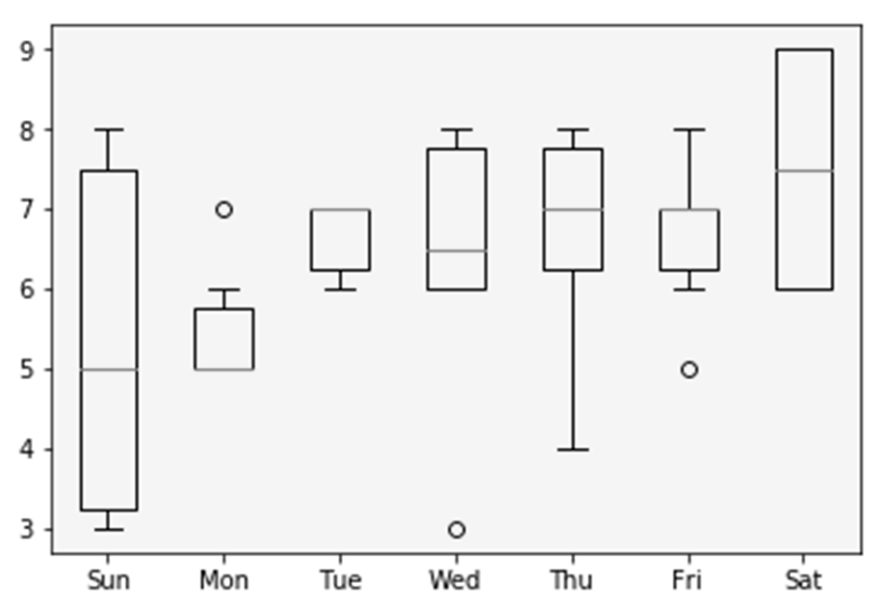
Output from Example 1
From the output, we can tell that most of the students do get more than 6 hours of sleep on most days, and do especially well on Saturdays.
However, there is a huge disparity of sleep patterns on Sunday where some students get much less sleep than others.
Most students sleep very little on Mondays with little difference. The sleeping patterns of Tue, and Fri also have little variation.
Thu sleep patterns vary by quite a lot though

Slide 51
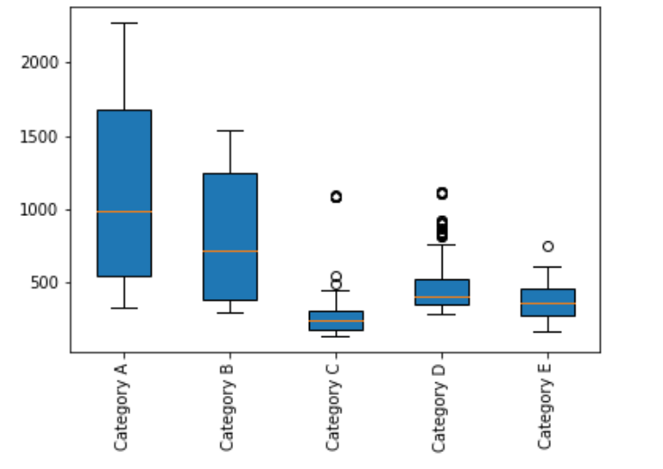
Output from Example 2

Slide 52
The End

Slide 53
